Slide 1
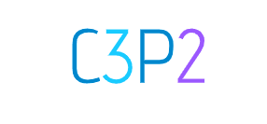
👋🏽🌎!

Slide 2
What's new Hunnigan?

Slide 3

Advances & Readjustments
30/11/20 - 11/01/21
Project Plan
V&V
5
6
Events and phase durations modified
Specified acceptance criteria
Design
Implementation
10
5
Specified Visual Designs (GUI)
Features working today

Slide 4


Plan Adjustments
Sprint 02
Sprint 04
Sprint 03
Beta 1

Slide 5
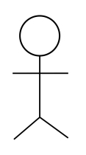

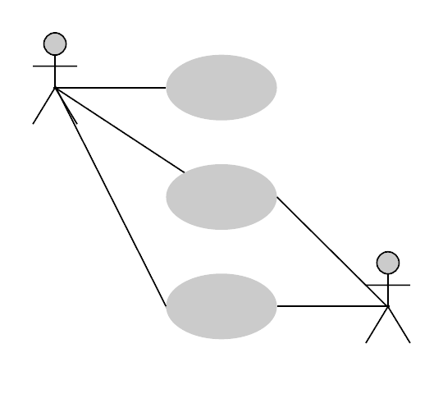
V&V
From case of use to human based acceptance criteria

Slide 6
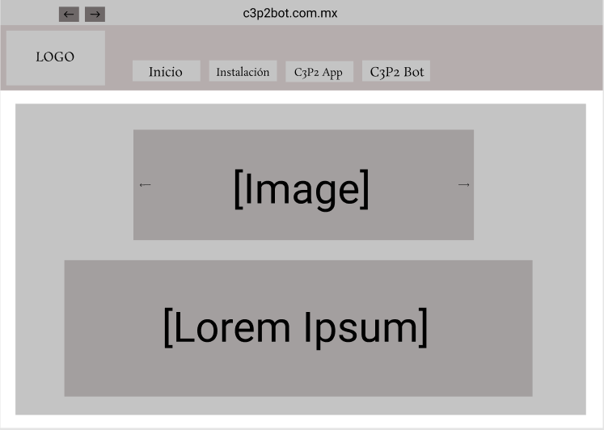

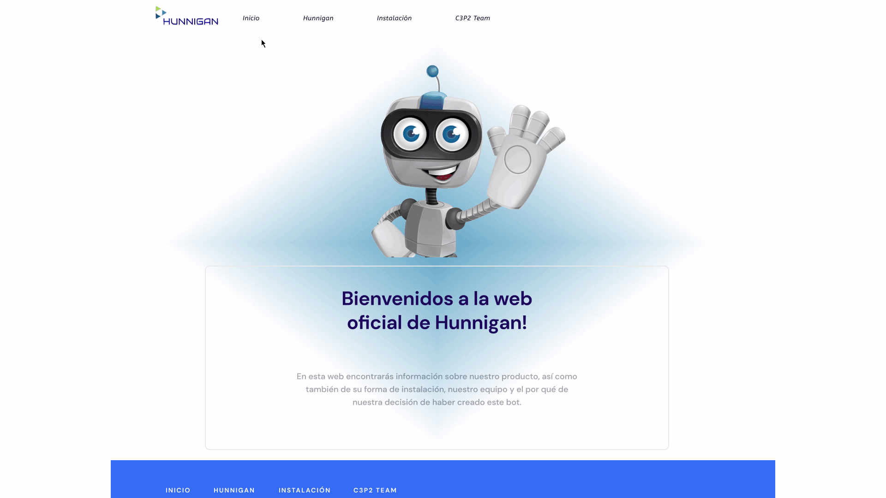
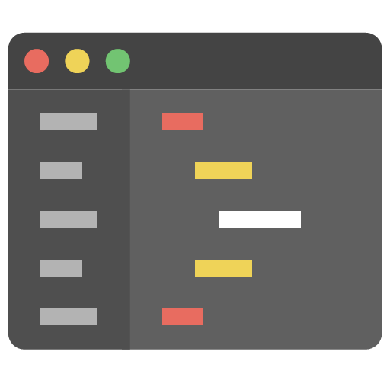
Design -> Implementation
Visual Prototype
Wireframe
Code

Slide 7
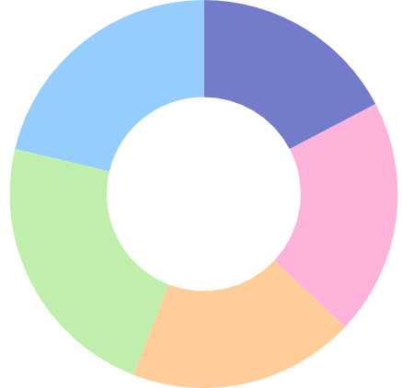
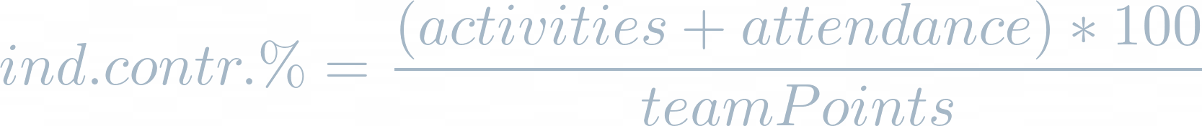
Individual Contribution
Tony
21.3 %
17.3%
Esteban
🤖
Angel
19.7%
Castul
22.8%
Erik
18.9%
It is measured with the formula:

Slide 8
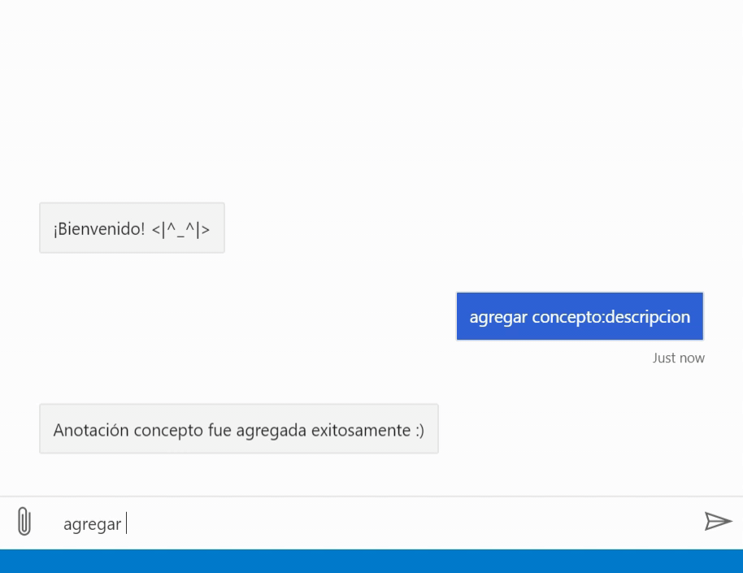
Make it happen! 🎉

Slide 9
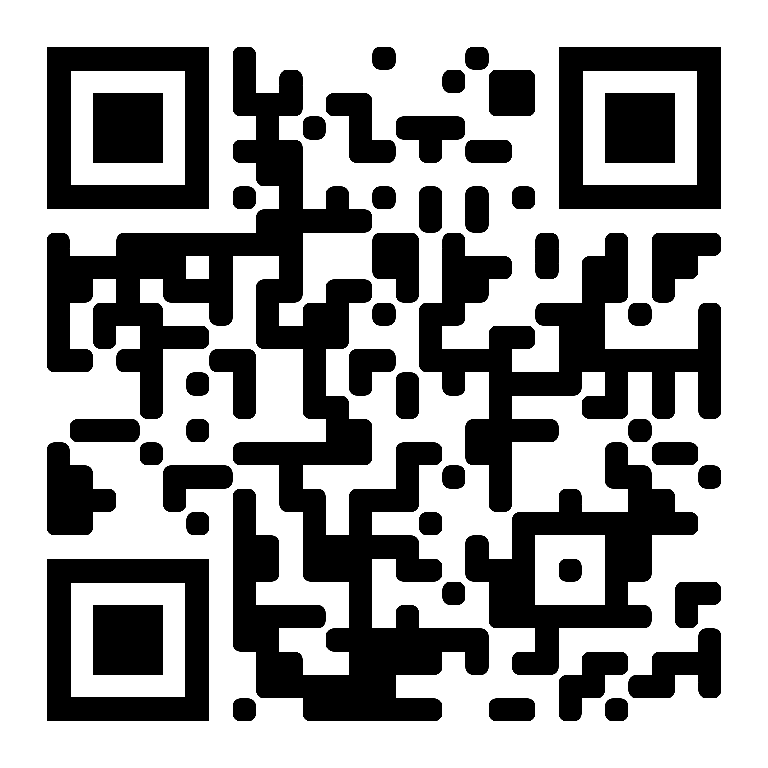

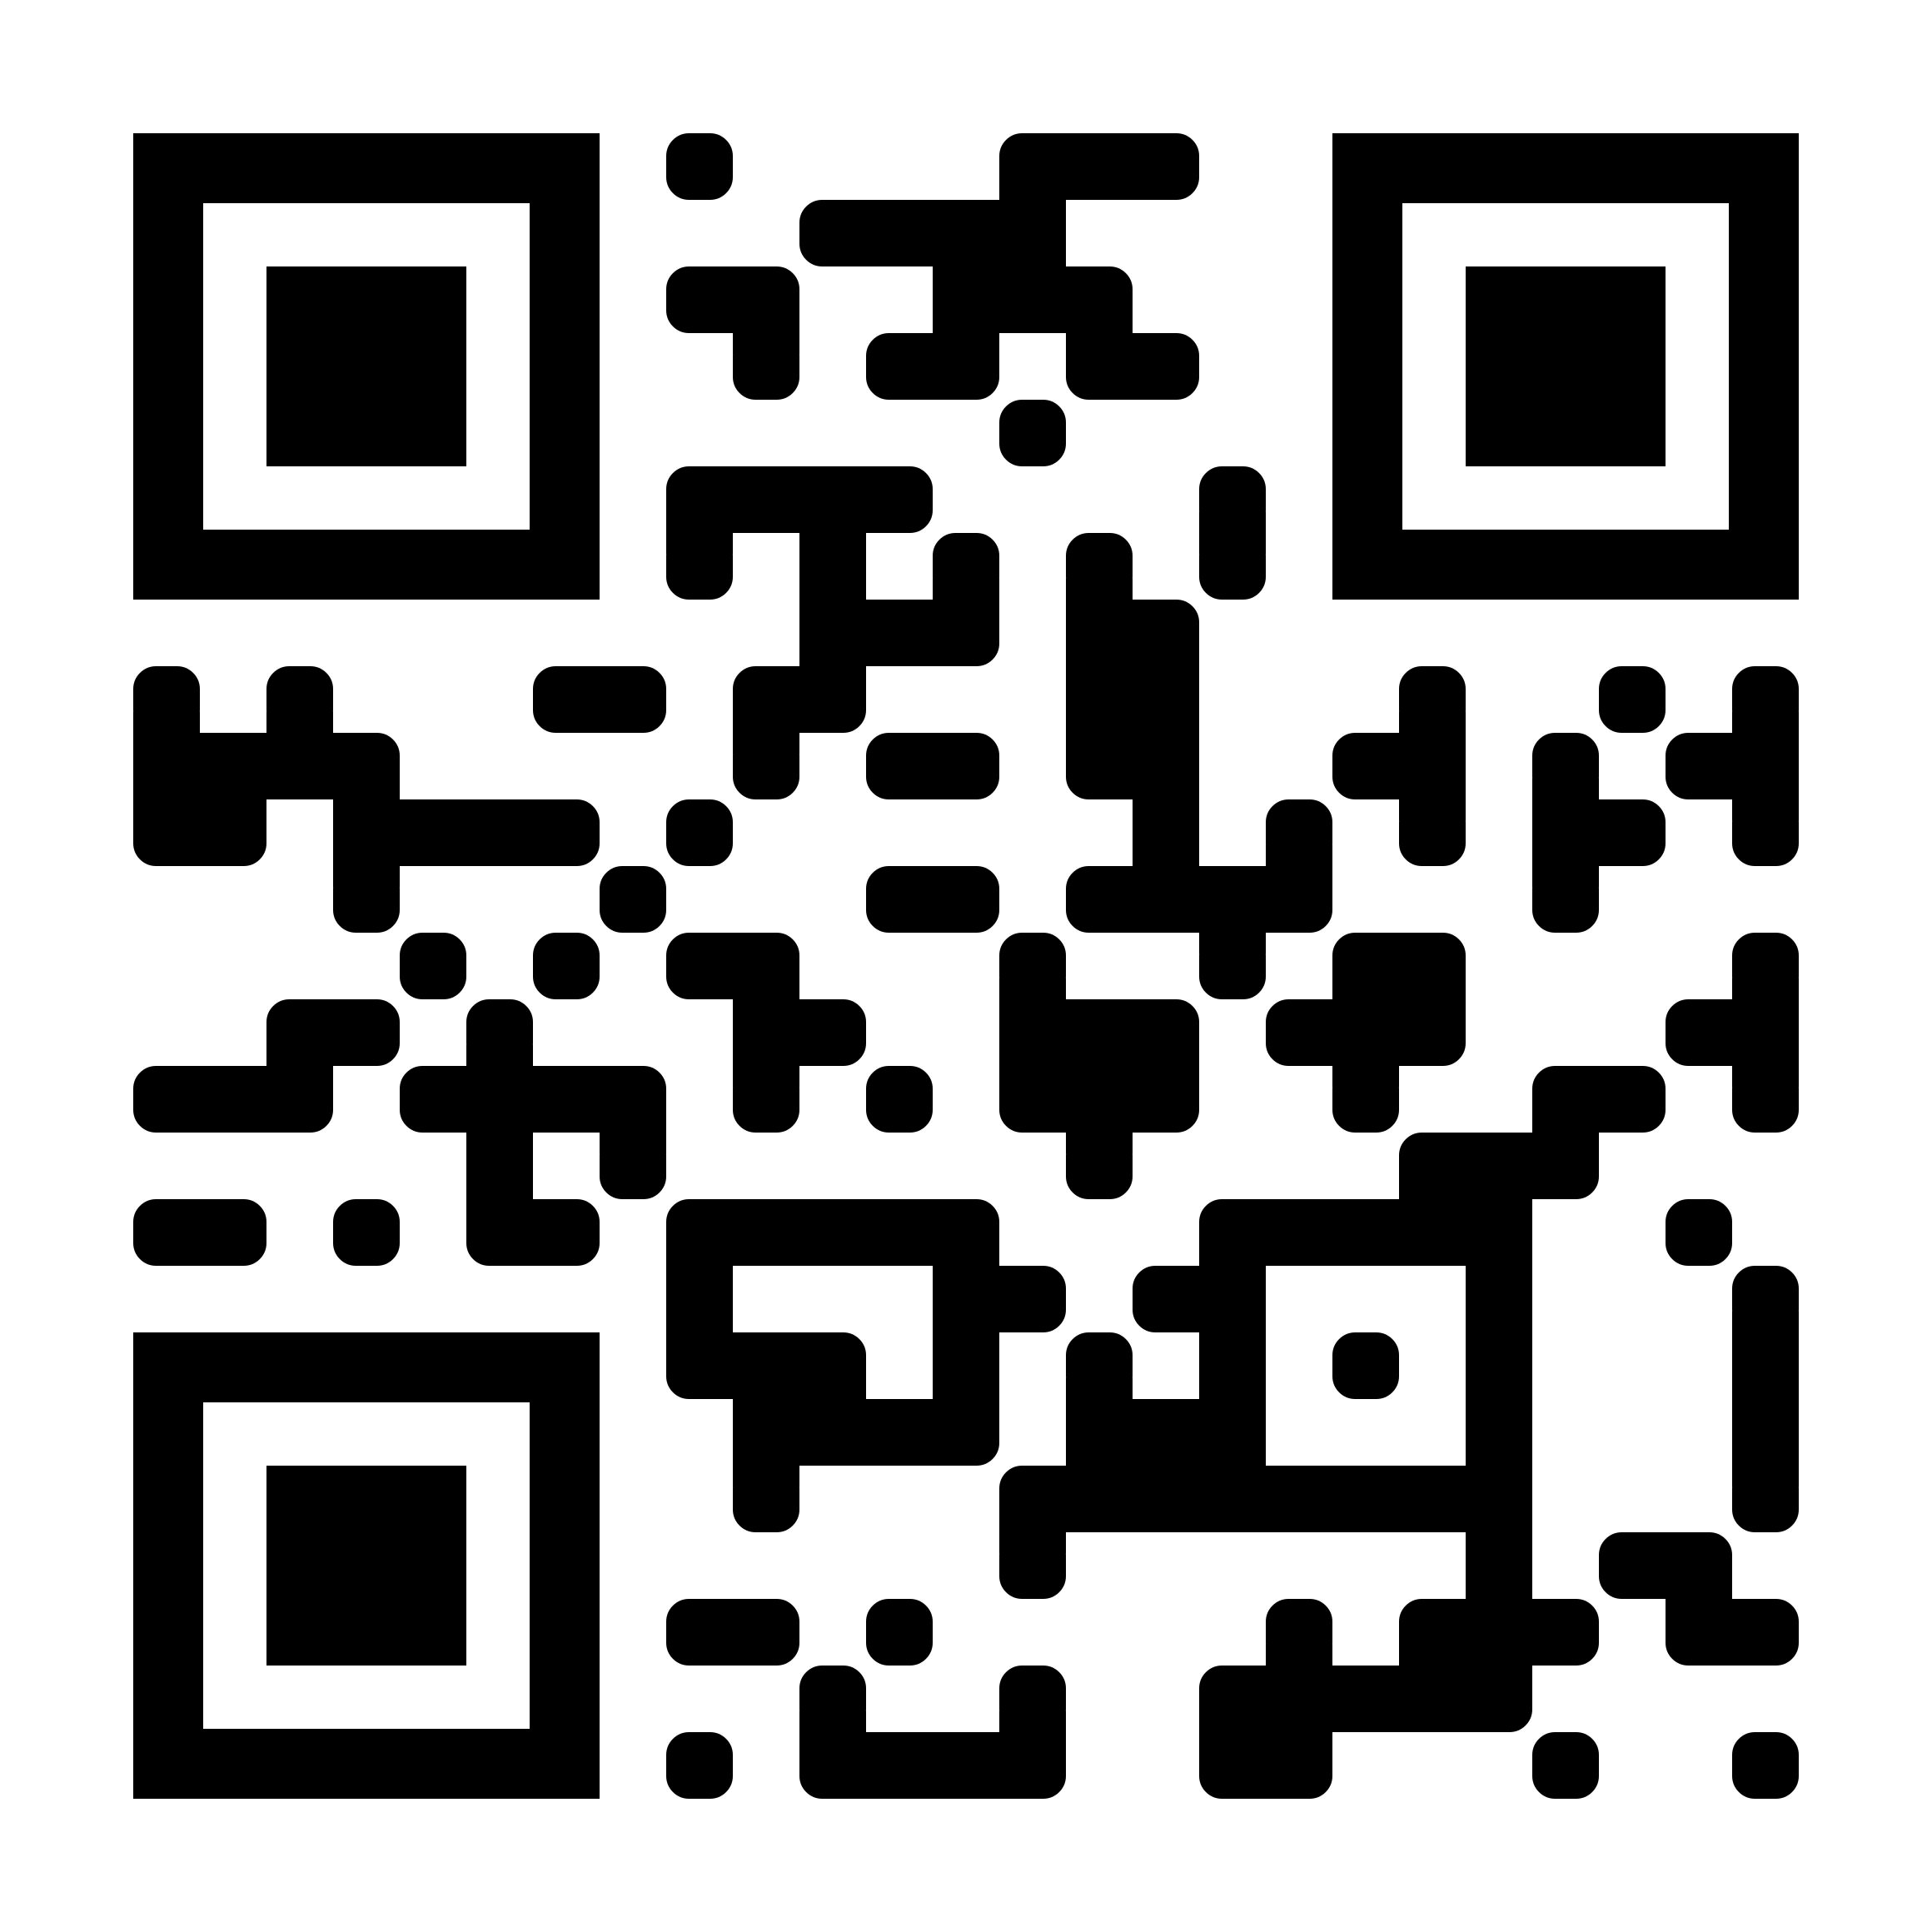
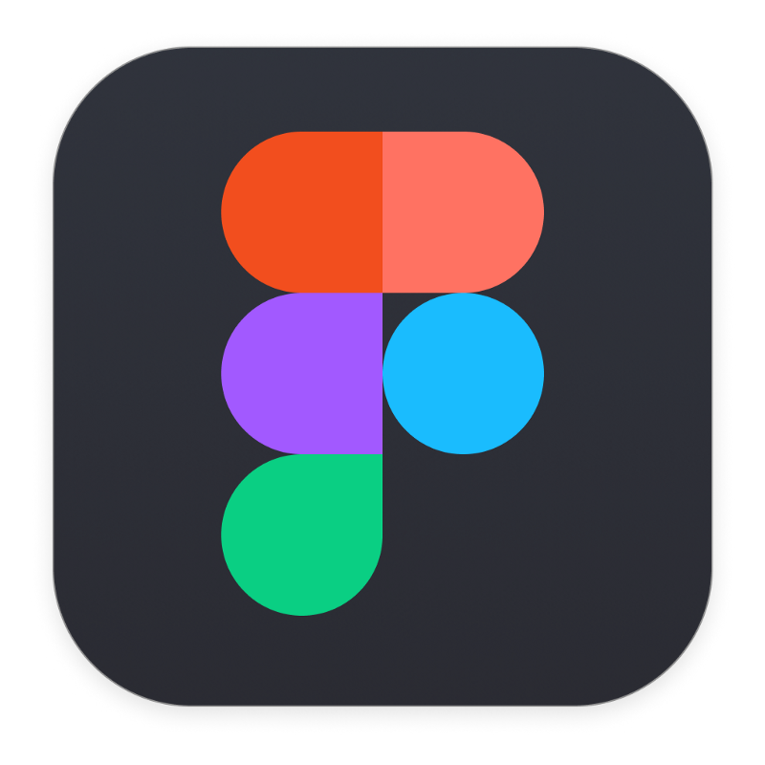
THANKS FOR YOUR ATTENTION
Visit the docs and source at: Hunnigan
Or the figma prototype:

